Slide 1

Binary Tree Representation: Array and Linked List Representation
Data Structure | Tree and Heap
Course: Data Structure | Chapter: Tree and Heap | Program: Bachelor of Engineering | Institution: Chandigarh University
DISCOVER · LEARN · EMPOWER
Notes:
Welcome everyone to today's session on Binary Tree representations. We will explore how to store tree data efficiently using two distinct methods. This topic is crucial for understanding memory management in complex data structures. Let us begin our journey into the world of trees.

Slide 2
Course Outcomes
SLIDE 2 / 14
Course Outcome
CO | BT LEVEL | DESCRIPTION
CO1 | BT1 | Understand and apply basic data structures, algorithms, complexity analysis, ADTs, arrays and linked lists.
CO2 | BT2 | Apply and implement stacks and queues in problem-solving.
CO3 | BT3 | Analyse and apply searching, sorting, and hashing techniques.
CO4 | BT4 | Construct and apply tree structures and traversal techniques.
CO5 | BT5 | Represent and solve graph problems using DFS, BFS, and graph algorithms.
Chandigarh University
2 / 14
Notes:
Today's lecture directly addresses our Course Outcomes. CO4 focuses on constructing tree structures, which we will do using arrays and linked lists. CO5 relates to graph algorithms, as trees are a special case of graphs. Mastering these representations helps you solve complex graph traversal problems later.

Slide 3
Learning Objectives
SLIDE 3 / 14
Learning Outcomes
1
Analyze the structural differences between array and linked list storage.
2
Evaluate the space complexity trade-offs for dense versus sparse trees.
3
Construct a binary tree representation using a one-dimensional array.
4
Implement dynamic node linking using pointers for flexible tree growth.
5
Compare performance metrics for insertion and deletion operations in both methods.
Chandigarh University
3 / 14
Notes:
By the end of this session, you will be able to analyze how memory is allocated differently in these two methods. We will evaluate why one method is better for complete trees while the other suits dynamic structures. You will construct examples for both and compare their performance metrics for common operations.

Slide 4
Lecture
SLIDE 4 / 14
Array Representation Fundamentals
1
Stores tree nodes in a contiguous one-dimensional array sequentially.
2
Root node is always placed at index zero of the array.
3
Left child of node at index i is located at index 2i + 1.
4
Right child of node at index i is located at index 2i + 2.
5
Parent of node at index i is located at index floor((i - 1) / 2).
6
Requires pre-allocation of maximum possible size for the tree structure.
Chandigarh University
4 / 14
Notes:
The array representation relies on a mathematical relationship between parent and child indices. If the root is at index 0, its left child is at 1 and right at 2. This pattern continues recursively for all levels. This method is intuitive but requires knowing the maximum tree size beforehand.

Slide 5
Lecture
SLIDE 5 / 14
Linked List Representation Fundamentals
1
Each node contains data, a left pointer, and a right pointer.
2
Nodes are allocated dynamically on the heap during runtime execution.
3
Null pointers indicate the absence of a child node in the tree.
4
Root pointer holds the address of the first node in the structure.
5
Memory usage is proportional to the actual number of nodes present.
6
Allows for easy insertion and deletion without shifting existing elements.
Chandigarh University
5 / 14
Notes:
In contrast to arrays, linked lists use pointers to connect nodes dynamically. Each node acts as a small container with data and two links. Null pointers signify the end of a branch, preventing errors. This flexibility allows the tree to grow or shrink without fixed memory limits.

Slide 6
Worked Example
SLIDE 6 / 14
Array Mapping
GOVERNING EQUATION
Node 20 is stored at index 2(0) + 1 = 1
1
Consider a tree with root 10, left child 20, right child 30.
2
Node 10 is stored at array index 0.
3
Node 30 is stored at index 2(0) + 2 = 2.
4
If node 20 has left child 40, it goes to index 2(1) + 1 = 3.
5
Array state becomes [10, 20, 30, 40, null, null, null] for this example.
Chandigarh University
6 / 14
Notes:
Let us calculate the indices for a simple tree. Root 10 is at index 0. Its left child 20 goes to index 1, and right child 30 goes to index 2. If 20 has a child 40, we calculate 2 × 1 plus 1, which equals 3. This demonstrates how the array fills up based on position.

Slide 7
Worked Example
SLIDE 7 / 14
Linked Construction
1
Create a node object with data 10 and null left and right pointers.
2
Assign root pointer to point to this newly created node object.
3
Create a second node with data 20 and link it as left child.
4
Create a third node with data 30 and link it as right child.
5
Update root.left to point to node 20 and root.right to node 30.
6
Memory addresses are assigned dynamically by the operating system allocator.
Chandigarh University
7 / 14
Notes:
Now let us build the same tree using linked nodes. We start by allocating memory for the root node with value 10. Next, we allocate memory for node 20 and update the root's left pointer to point to it. We repeat this for node 30 on the right side. The memory addresses are not sequential like in arrays.

Slide 8
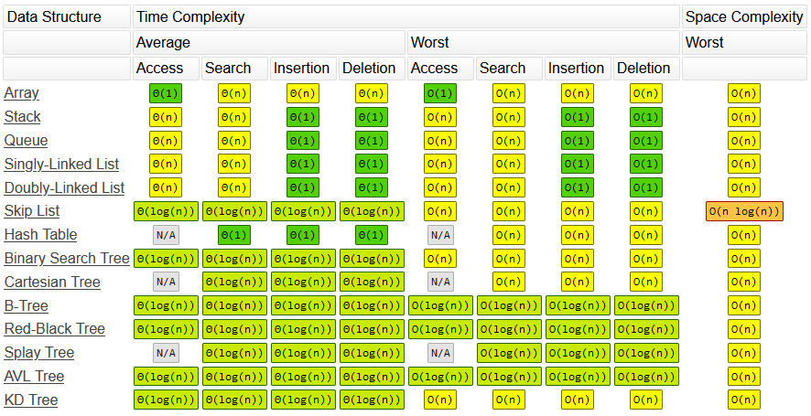
Lecture
SLIDE 8 / 14
Space Complexity Analysis
1
Array method uses O(n) space but may waste space for sparse trees.
2
Linked method uses O(n) space where n is the actual node count.
3
Sparse trees in arrays require null placeholders for missing children nodes.
4
Linked lists only allocate memory for existing nodes and their pointers.
5
Array overhead is minimal for complete binary trees with no gaps.
6
Linked list overhead includes pointer storage for every single node created.
Source: paulmcd.dev
Chandigarh University
8 / 14
Notes:
Space complexity is a critical factor in choosing a representation. Arrays can waste significant memory if the tree is sparse, as empty slots must be reserved. Linked lists are more space-efficient for irregular trees since they only store existing nodes. However, linked lists incur overhead from storing two pointers per node.

Slide 9
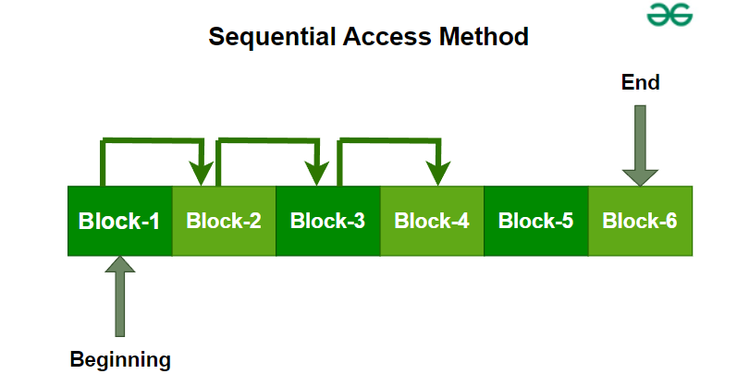
Time Complexity
SLIDE 9 / 14
Access Operations
1
Array access to any node by index is an O(1) constant time operation.
2
Linked list access requires traversing from the root, taking O(h) time.
3
h represents the height of the tree in the linked representation.
4
Finding the k-th node in an array is faster than in a linked list.
5
Linked list traversal is necessary to locate any specific node in the tree.
6
Array access is direct while linked access is sequential and pointer-based.
Source: media.geeksforgeeks.org
Chandigarh University
9 / 14
Notes:
Access speed differs significantly between the two methods. In an array, you can jump directly to any node using its index in constant time. In a linked list, you must traverse from the root down to the target node. This traversal time depends on the height of the tree, making it slower for deep trees.

Slide 10
Common Pitfalls
SLIDE 10 / 14
Array Representation
1
Failing to pre-calculate the maximum tree size leads to overflow errors.
2
Using 1-based indexing instead of 0-based indexing breaks child formulas.
3
Ignoring null placeholders causes incorrect traversal results in sparse trees.
4
Dynamic resizing of arrays is computationally expensive and complex to implement.
5
Misinterpreting the parent formula for odd or even indices creates bugs.
6
Assuming array size equals node count without accounting for gaps.
Chandigarh University
10 / 14
Notes:
Students often make mistakes with array representations. A common error is using 1-based indexing, which breaks the standard formulas for children and parents. Another pitfall is underestimating the space needed for sparse trees, leading to wasted memory. Always verify your indexing logic before implementation.

Slide 11
Common Pitfalls
SLIDE 11 / 14
Linked Representation
1
Forgetting to initialize pointers to null causes segmentation faults on access.
2
Creating memory leaks by failing to free nodes during deletion operations.
3
Circular references in pointers can cause infinite loops during traversal.
4
Incorrect pointer updates during insertion can disconnect parts of the tree.
5
Not checking for null before dereferencing pointers leads to runtime crashes.
6
Confusing the root pointer with the current node pointer during traversal.
Chandigarh University
11 / 14
Notes:
Linked lists introduce different challenges, primarily related to memory management. Forgetting to set pointers to null can cause crashes when accessing non-existent children. Memory leaks occur if you delete nodes but fail to free their allocated memory. Always validate pointers before dereferencing them to ensure safety.

Slide 12
Lecture
SLIDE 12 / 14
Performance Comparison Summary
1
Arrays excel in random access and cache locality for dense structures.
2
Linked lists excel in dynamic insertion and deletion without shifting data.
3
Arrays are preferred for heap implementations due to contiguous memory layout.
4
Linked lists are preferred for general binary trees with irregular shapes.
5
Array traversal is faster due to sequential memory access patterns.
6
Linked list traversal is slower due to pointer chasing and cache misses.
Chandigarh University
12 / 14
Notes:
To summarize, arrays are superior for random access and cache performance, making them ideal for heaps. Linked lists offer flexibility for dynamic changes, making them better for general trees. The choice depends on whether your application requires frequent insertions or fast random access. Consider your specific use case before deciding.

Slide 13
Lecture
SLIDE 13 / 14
Key Takeaways
GOVERNING EQUATION
Array representation uses index formulas: left=2i+1, right=2i+2, parent=(i-1)/2
1
Linked representation uses pointers for dynamic memory allocation and flexibility.
2
Arrays waste space for sparse trees but offer O(1) random access.
3
Linked lists use memory proportional to nodes but require O(h) access.
4
Choose array for complete trees/heaps and linked for dynamic sparse trees.
Chandigarh University
13 / 14
Notes:
Remember the index formulas for array representation as they are fundamental. Linked lists provide dynamic flexibility but come with pointer management overhead. Always consider the sparsity of your tree when choosing a representation. Arrays are best for heaps, while linked lists suit dynamic general trees.

Slide 14
Lecture
SLIDE 14 / 14
References
DATA STRUCTURES
A Pseudocode Approach with C — Gilberg, Forouzan
• Data Structures — Lipschutz
• Data Structure Using C — AK Sharma
• C and Data structure — P. S. Deshpandey
Chandigarh University
14 / 14
Notes:
These textbooks provide comprehensive coverage of data structures and their implementations. Gilberg and Forouzan offer excellent pseudocode approaches for understanding logic. Lipschutz and Sharma provide practical C implementations for hands-on learning. Please refer to these resources for deeper insights and practice problems.

